Slide 1
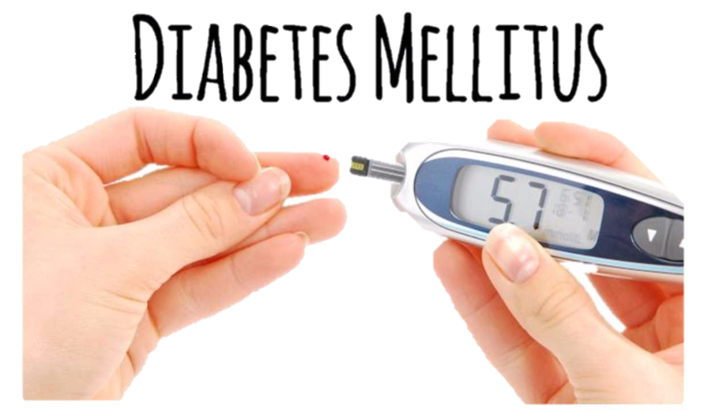
Prediction of diabetes using machine learning

Slide 2
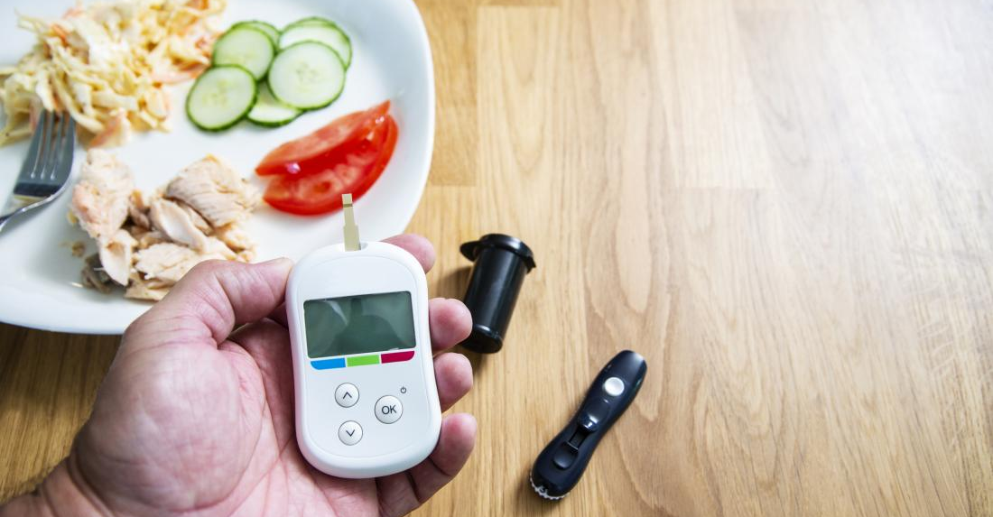
What is Diabetes ?

Slide 3
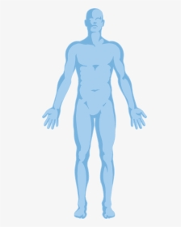
Early Signs Of Diabetes
Extreme Fatigue
Blurred Vision
Unusual Thirst
Weight Loss
Dark Patches
Frequent or Recurring Infections
Tingling or Numbness
Increased Hunger
Itchy

Slide 4
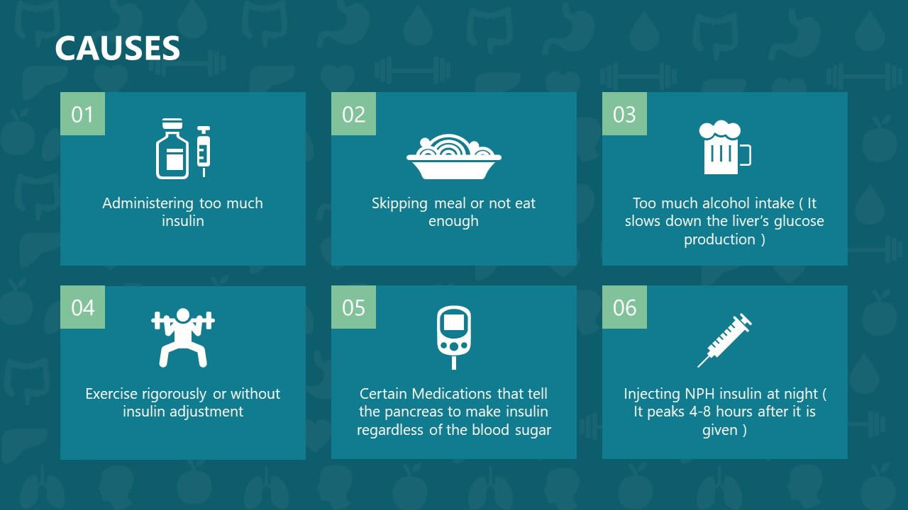

Slide 5
TYPE 1 DIABETES
Typically associated with : Children to young adults
Risk Factors : Generic or Environmental Factors
TYPE 2 DIABETES
Typically associated with : Adult onset
Risk Factors : Obesity, older age, family of personal history of disease
Accounts for : 90 – 95 % of all cases
Treated with : Insulin
Accounts for : 5% of all cases
Preventable : No
GESTATIONAL DIABETES
Typically associated with : Pregnant woman
Risk Factors : Obesity or family history of diabetes
Treated with : Diet, exercise and sometimes with oral drugs or insulin
Preventable : Yes
Treated with : Diet and exercise or insulin
Preventable : Recent studies suggest there may be ways to prevent some cases
Accounts for : upto 9 of pregnant woman
TYPES OF DIABETES

Slide 6
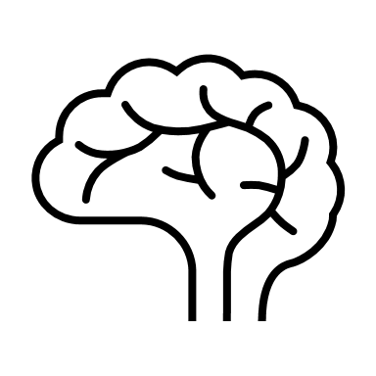
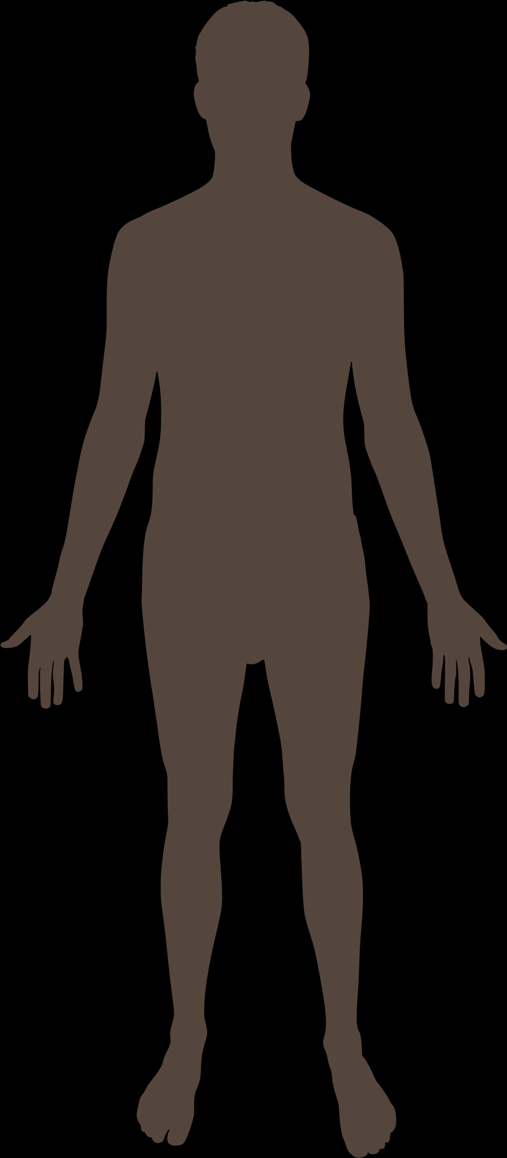

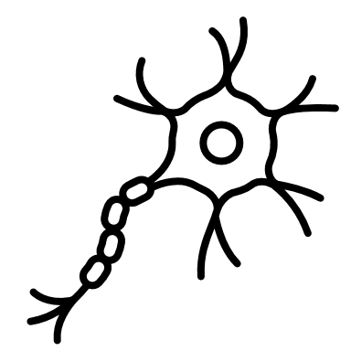



RISK AND FURTHER COMPLICATIONS
Diabetes can lead to a number of further complications, including :
Stroke
Eye Disease
Nerve Damage
Heart Disease
Kidney Disease
Diabetic Foot

Slide 7
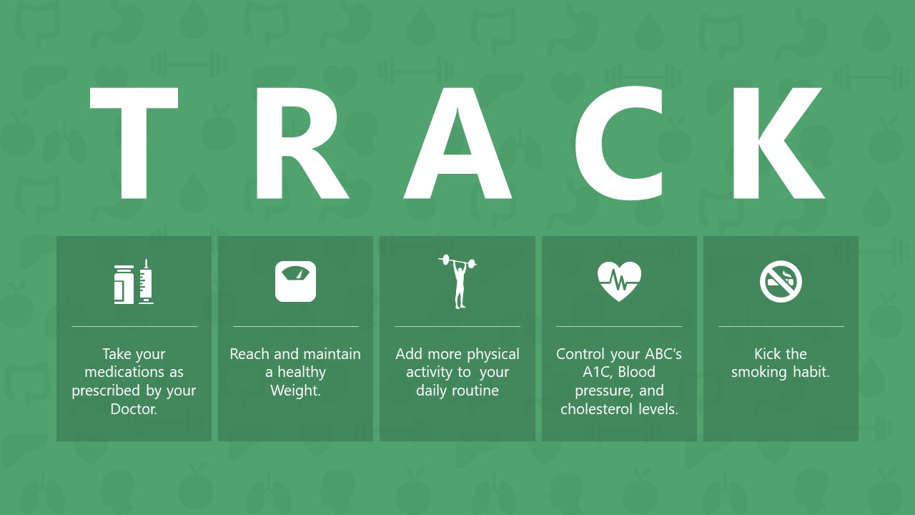

Slide 8
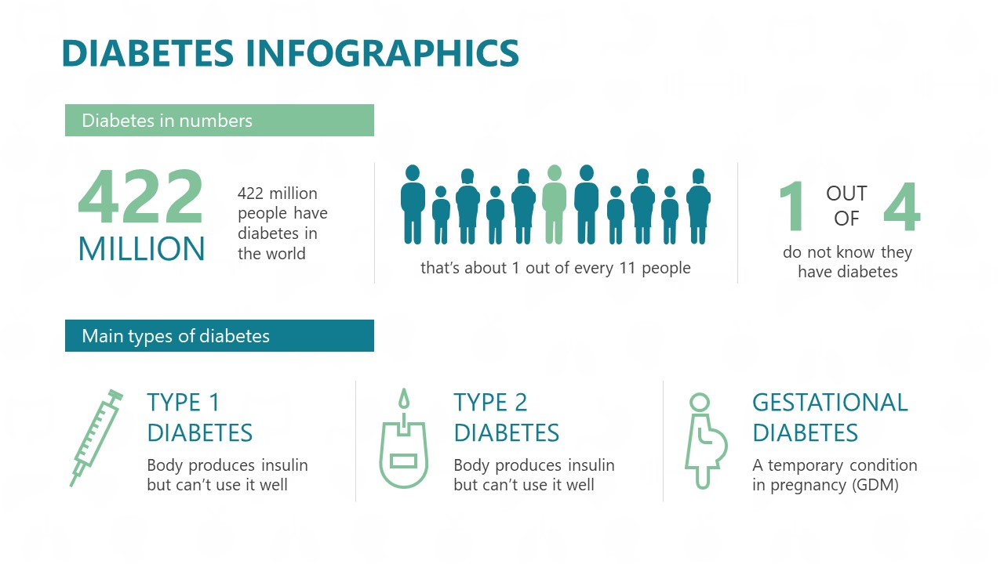

Slide 9
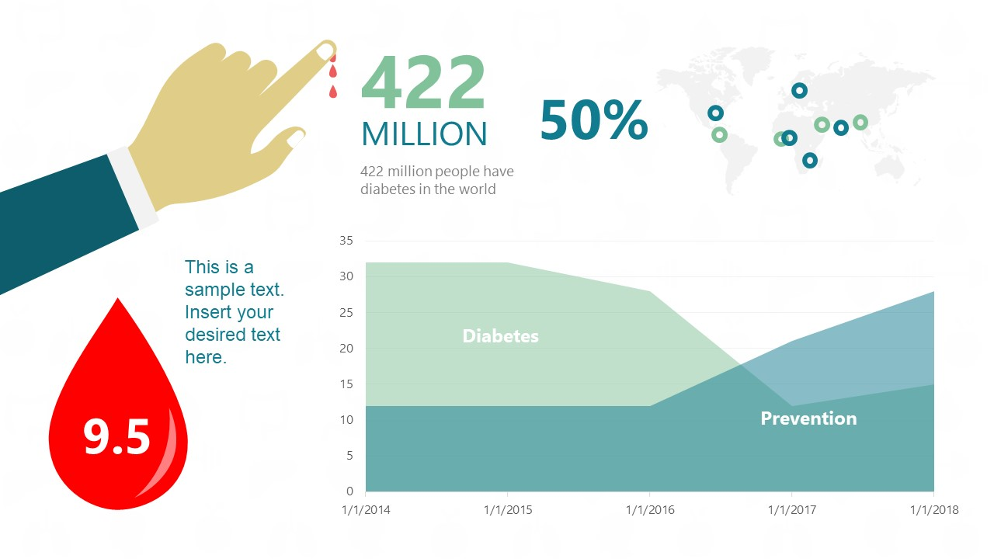


Slide 10

How we can Help ?

Slide 11
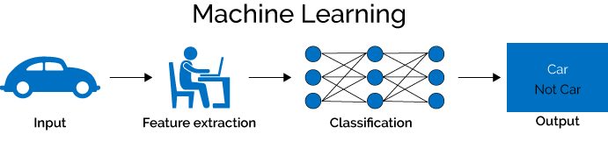
The Machine Learning Process
Machine Learning is an aspect of Artificial Intelligence which can enable computers to learn with experience, much like humans, without us being needed to program them every single time.
ML is data driven. This simply means that we feed the data to our machine and then it has the potential to learn and draw patterns, and ultimately help in predicting the outcome of an unknown or unmarked value.

Slide 12
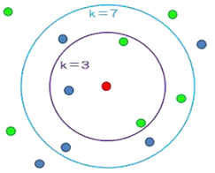
K-Nearest Neighbors
K-Nearest Neighbor is considered a lazy learning algorithm that classifies data sets based on their similarity with neighbors.
“K” stands for number of data set items that are considered for the classification.
Ex: Image shows classification for different k-values

Slide 13
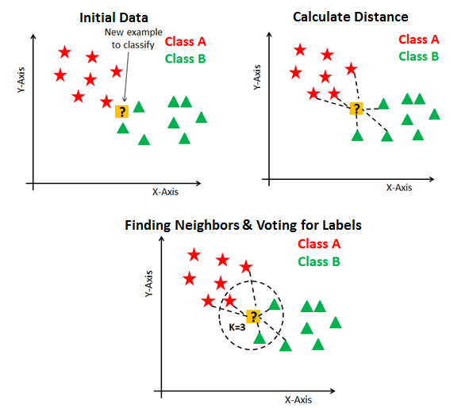

Slide 14

Some Points about K-NN algorithm
Very simple and intuitive
Good classification if the number of samples is large enough
Dependent on K Value
No training stage, all the work is done during the test stage
This is actually the opposite of what we want. Usually we can afford training step to take a long time, but we want fast test step
Need large number of samples for accuracy

Slide 15

Thank You

